Slide 1



Namma Yatri data analysis
-Data-Driven insight & strategic recommendations
Business Analysts:
ZAYED SYED
GSS VINAY
SRUSHTI KESKAR

Slide 2

About Namma -Yatri
Namma Yatri is a Direct-to-Driver open mobility platform developed by Juspay, designed to power the next generation of mobility applications in India. Since its official launch in January 2023, it has become Bengaluru’s most loved auto-rickshaw app.
Let me know if you'd like it to sound more formal, promotional, or tailored for a specific audience (e.g., investors, users, media).

Slide 3
Executive Summary
Project Overview:
Analysis of Namma Yatri data to derive actionable insights.
Focus on improving operational efficiency and marketing strategies.
Data-driven recommendations for business growth.
Key Objective: Understand user behavior, ride performance, and revenue drivers
Tools: Power BI, Data Modelling, Visualization
Outcome: Actionable insights and strategy suggestions.

Slide 4
Business Context & Problem Statement
Rising ride demand but inconsistent performance
Need for data-backed operational and marketing insights

Slide 5
Data Cleaning and Integration
Imported and joined multiple tables in Tableau/Power BI.
Ensured data accuracy by resolving inconsistencies.
Created calculated fields for relevant analysis

Slide 6
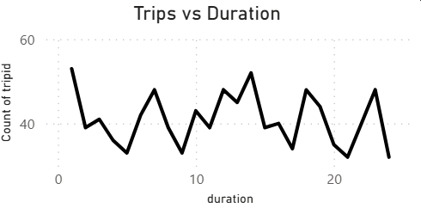
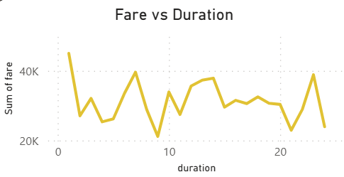
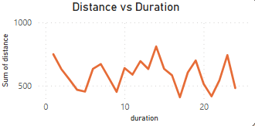
Ride Demand
From the graphs we can observe:
Highest number of trips have been taken between 12am to 1am at night and therefore, highest sum of fare.
Lowest demand is around 11pm to 12pm.
At around 2pm in the afternoon, the trips are for higher distance compared to the rest of day.

Slide 7
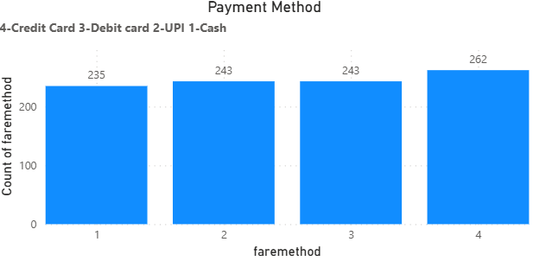
Payment Method Analysis
We can observe that all he payment methods are used almost equally by the travellers,
But still, Credit card usage is higher as compared to any other payment method.

Slide 8
Trip Trends Across Zones
Mahadevapura and Bommanahalli - heavy usage during morning hours.
Bangalore South: steady ride pattern throughout the day.
Ramanagaram: peaks in the night.

Slide 9
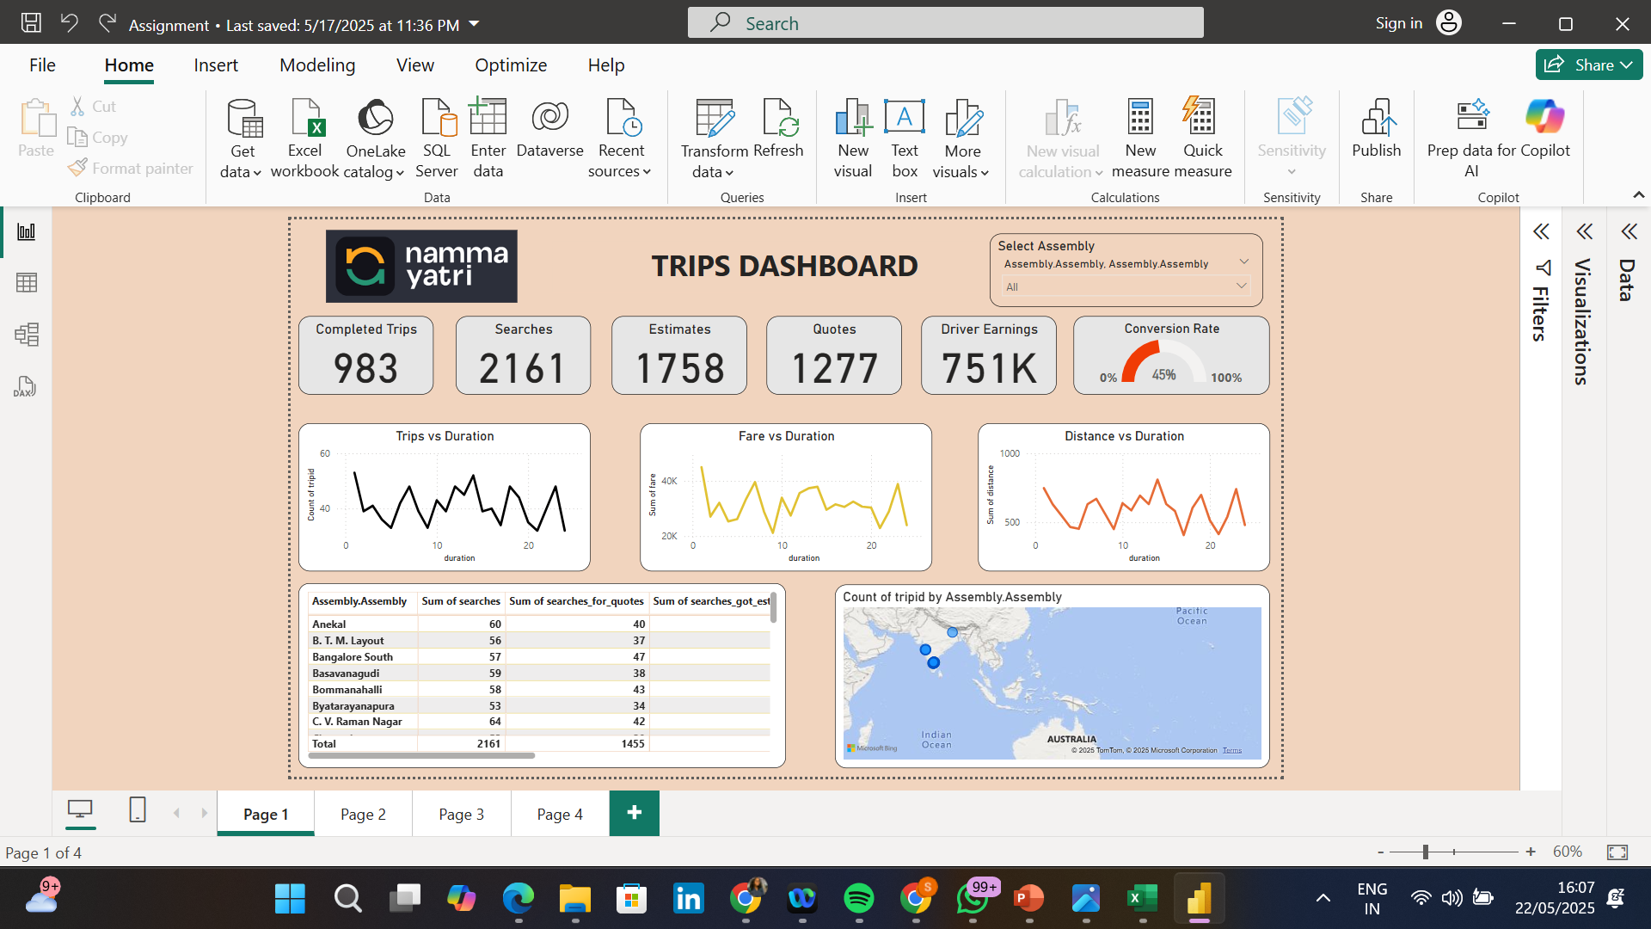
Power BI Dashboard

Slide 10
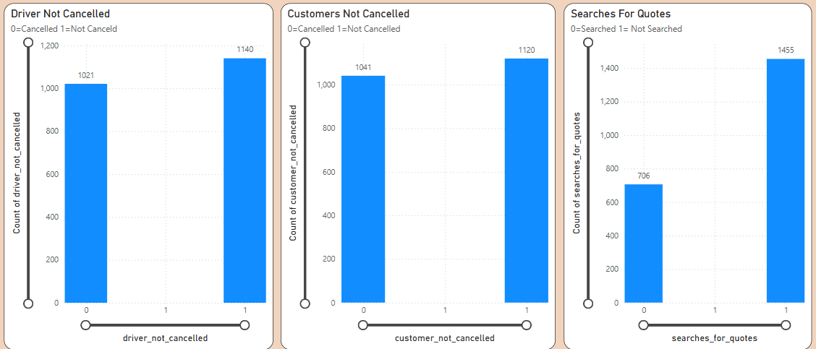
Analysis of Cancellations and Successful Rides
We can see from the graphs, that the cancellation done by drivers and the customers is almost equal.
Also, the customers have gone ahead with the trip instead of searching for quotes.

Slide 11
Strategic Recommendations
Promote the quote search feature.
Incentivize completion and improve communication.
Implement cancellation reason tracking and penalties.
Focus on high-cancellation locations and predictive alerts.

Slide 12
Thank You

